Slide 1
Bank Marketing
Classification
December 19

Slide 2
Table of contents
01
Introduction
02
Design
03
Exploratory Data Analysis
04
Algorithms
05
Models
06
Tools

Slide 3
01
Introduction

Slide 4
Introduction
The data is related with direct marketing campaigns (phone calls) of a Portuguese banking institution.
The classification goal is to predict if the client will subscribe a term deposit (variable y).
Business Problem:
predict the success of a bank marketing campaign based on the features we have in out data. This project should therefore help us be better able to identify potential customers and refine our the focus of future campaigns.

Slide 5
02
Design

Slide 6
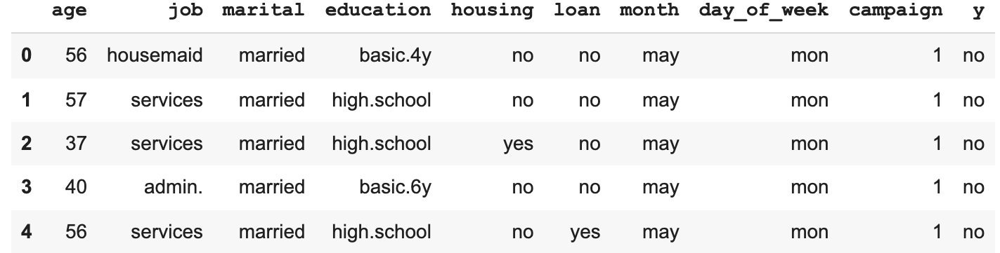
Dataset
Dataset source:
From Kaggle website [Kaggle]
Size of Data:
Number of rows: 41188
Number of columns: 21

Slide 7
Challenges
2. Imbalance data
1. Drop unknown variables
4. Long time to run
3. Find a best model

Slide 8
03
Exploratory Data Analysis

Slide 9
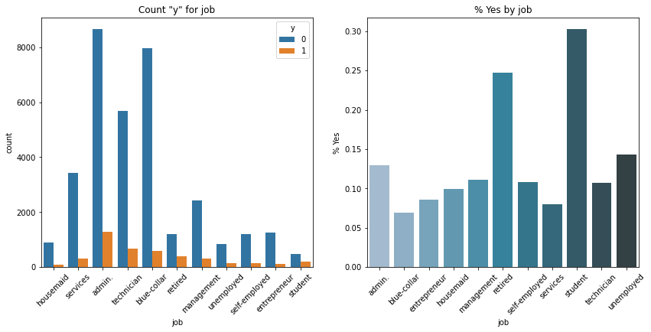
Counts of categorical variables

Slide 10
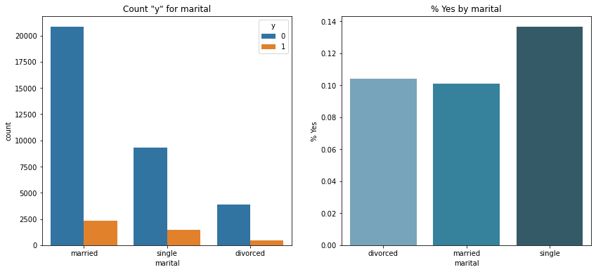
Counts of categorical variables

Slide 11
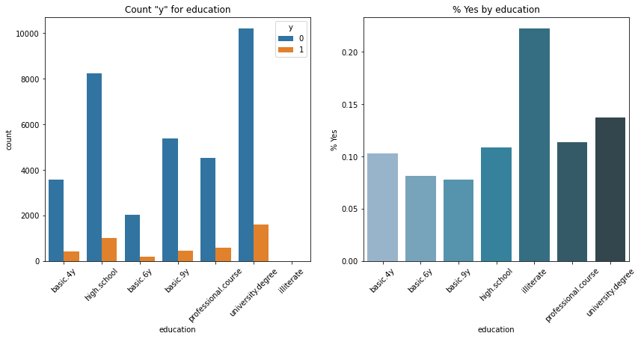
Counts of categorical variables

Slide 12
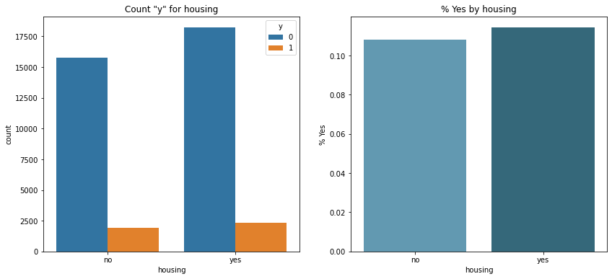
Counts of categorical variables

Slide 13
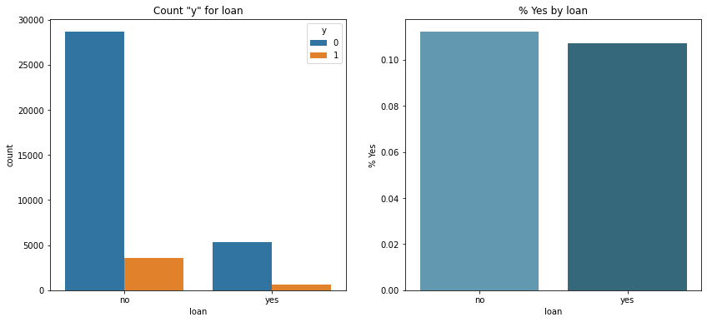
Counts of categorical variables

Slide 14
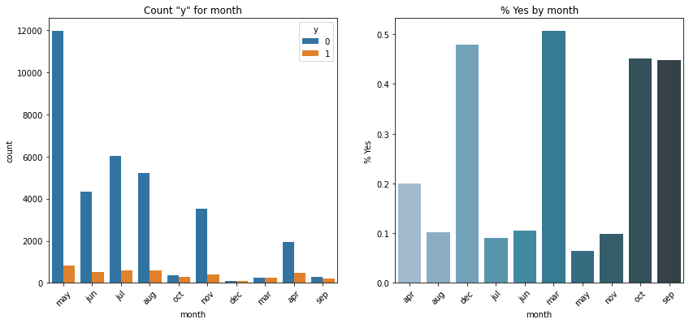
Counts of categorical variables

Slide 15
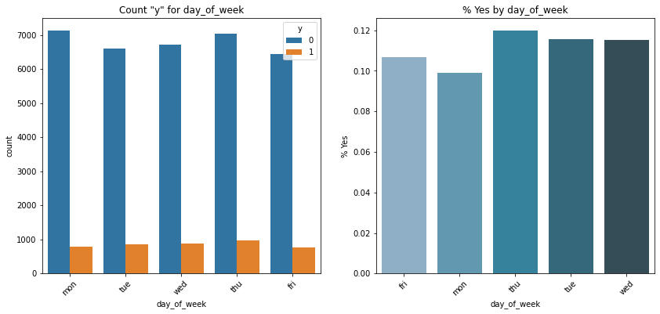
Counts of categorical variables

Slide 16
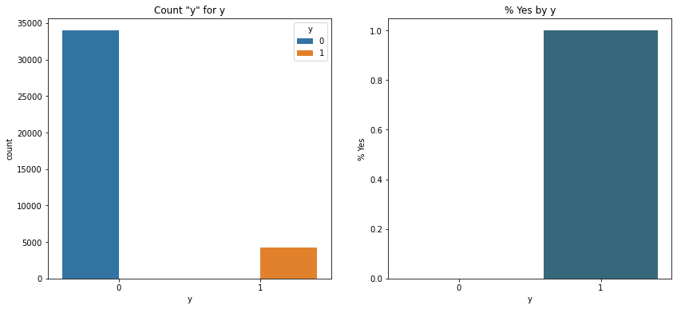
Counts of categorical variables

Slide 17
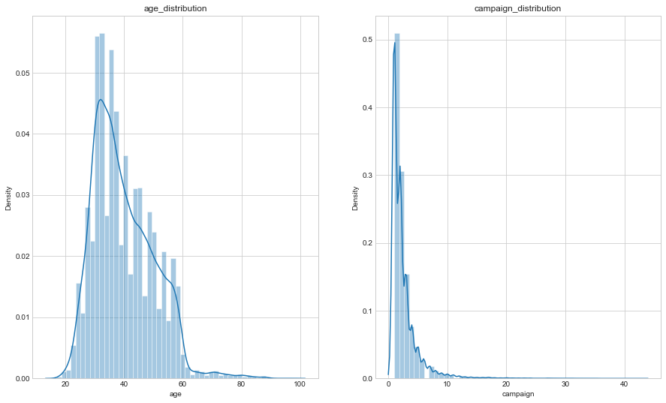
Distributions of continuous variables

Slide 18
04
Algorithms

Slide 19





Algorithms
Logistic Regression
k-Nearest Neighbours
Decision Tree
Random Forest
XGBoost

Slide 20
05
Models

Slide 21
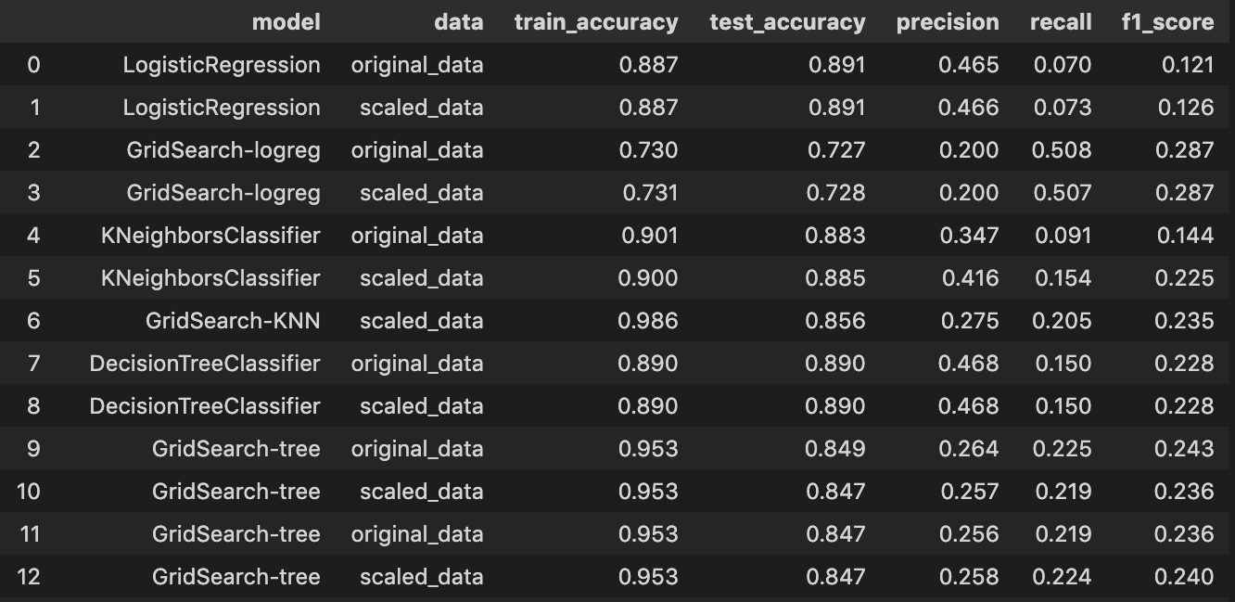
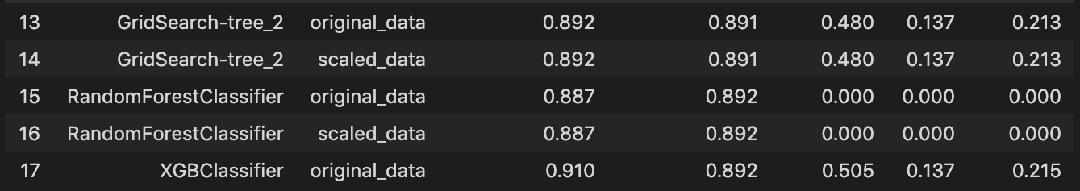

Slide 22
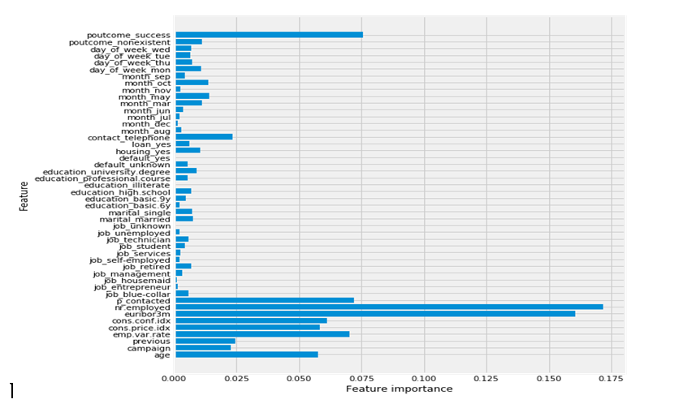

Slide 23
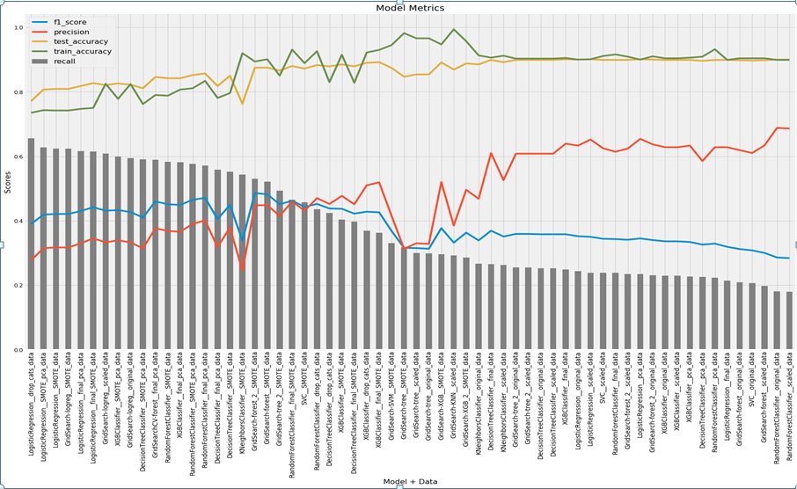

Slide 24
06
Tools
VScode
PowerPoint
Python
GitHub
Zoom

Slide 25
Conclusions
Images reveal large amounts of data, so remember: use an image instead of a long text. Your audience will appreciate it

Slide 26
Thanks!!
Do you have any questions?
Shaima Alzahrani
Nasser Alquraini
Raghad Alnasser

